Slide 1
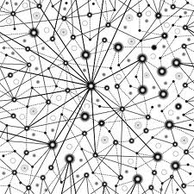
The Agile Paradox
Agility to manage complex programs, while adding (social) complexity
PGMopen 2016
Dr. Mr. Ben Berndt MBA-FSI
Head of CPMO NN Group
NN Group CPMO:
Pool of program managers
Portfolio management
Quality assurance
Financial planning & Control
Lean Six Sigma
Training facilities
Member of Glocomnet
ISCE Research

Slide 2
Presentation storyline
A little disclaimer; it’s my personal reflection; no science
Agile & self-organization
Agility to manage complexity in programs
  Both on program level and on project(s) level
But what is complexity (and complicatedness)
(get) PM (back) in the ideal complicated (management) domain (simplification)
Management of complex programs
  Management of uncertainty
  Management of social complexity (paradox)

Slide 3
Agile & Self-Organization
Remington and Pollack (2007) referring to “fast-track” state that these projects increase the level of complexity exponentially
Fewell, CST, PMP (2015): A true agile practitioner asks simple questions like: “are we all on the same page?” Might not be that simple (BB); since that implicitly refers to perception and world views, which relates to systems theory and social (perceived complexity)
Nicholson (N Cubed Consulting, 2015): “Transforming your business into an “agile” one, (it) becomes a complex mix of methodologies, psychologies, disciplines and negotiations…”
Bloomberg (Forbes Tech 2015): “Agile calls for self-organizing teams, but there remains no clear understanding of how best to self-organize”

Slide 4
Agile & Self-Organization
“Agile doesn’t mean total freedom, it means self-organization through some constraints says Henrique Imberti Jr., PMP. When a garden is not being managed, it will keep growing, but in another direction than what was intended. We, as project managers, need to be gardeners and grow our teams as intended.”
This presentation’s topic:
But a garden is a map; it’s not the territory. A garden is already organized.
Gardens belong to the “safe” management domain.
That’s not were self-organization happens, that emerges in the territory itself, you -as an agile manager- should be able to contrarily let go direction, let it flow and interfere with caution;
to be able to handle uncertainty; that –in my perception BB- is what agile is about.

Slide 5
Manage complex programs
Self-Organization = social complex
What is Complexity Complicatedness?
Complexity is the study of items which are more than just sum of their identifiable parts: a dead frog cannot be reassembled.
So complex is not the same as complicated.
We people can tackle complicatedness (via expertise), the complex we cannot really tackle, nor manage?
A Boeing 747 is (highly) complicated.
The weather, rainforests, traffic, social media, and a flog of seagulls are complex.

Slide 6
Manage complex programs
Project Complexity; not much consensus
most writers refer to interrelatedness (many varied interrelated parts e.g. Baccarini).
Others refer to perceived complexity: complexity is labeled here as subjective: not all perceive the same problematical situation, nor can an observer perceive the whole context, nor do all perceive the same context
(research by Chronéer & Bergquist, 2012).
  Components plus interactions plus context plus interpretations form a complex whole.
(ISCE Research, www.ISCE.edu)

Slide 7
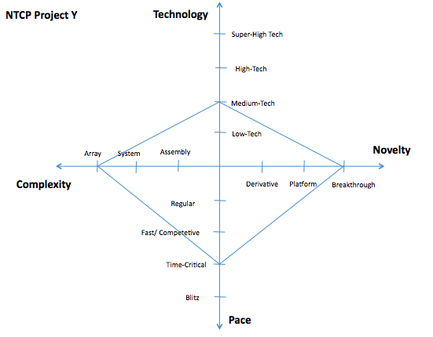
Program complexity:
NTCP Model (Shenhar & Dvir)
Relationships Technology & Novelty & Pace make it (more) complex

Slide 8
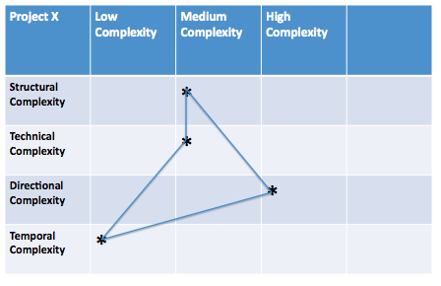
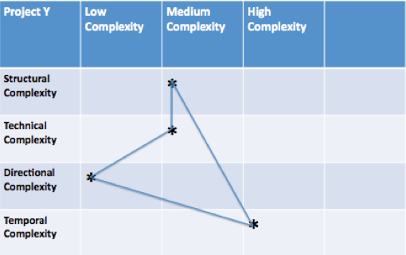
Program complexity:
Complexity Mapping (Remington & Pollack)
Structural extreme: "We can't see
the forest for the trees", "How can we
keep track of all the interdependencies”
Technically extreme: "How do we do or make it", "There is nothing like this out there”
Directionally extreme: "How do we share understanding", "No one seems to be on the same page”
Temporally extreme: "It is like standing on quicksand", "Everything keeps shifting”

Slide 9
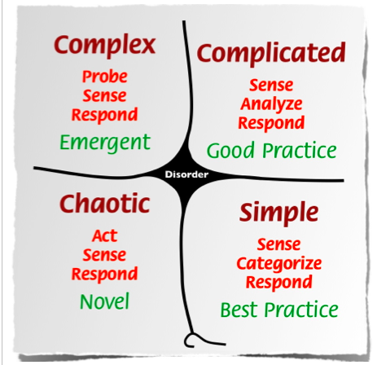
Manage complex programs
Complicated domain, ideal PM domain, that domain is all about management
Try not to make it more complex (simplify)
Unknown unknowns.
Uncertainty. You need to let go, watch patterns. Oh this is what it is about (retro). Probe first. Agile PM...
Known unknowns. Multiple answers. Expert domain. Sense: This could be about. Analyze.
Ideal PM landscape?
Agile, Waterfall, Hybrid
Crisis. No patterns. Act. See what happens & respond
Best Practice. Sense: This is what it is about. Categorize & respond. No PM needed?
Retrieved from Snowden & Boone, A leader’s framework for decision making. HBR, Nov. 2007.

Slide 10
Manage complex programs
Simplify
Complexity reduction
Laws of Simplicity (Meada 2006):
Reduce thoughtful. What do we really need
Organize (label, sort etc.). Makes systems of many appear fewer
Time. Shorten the chain (LEAN)
Learn. Knowledge makes things simpler
Differences. find inherent simplicity (beautiful code)
Context. What is the meaning of all that beyond focus?
Emotion. Challenge your sensitivity
Trust. Omakaze: chef’s choice
Failure. Some things won’t get simpler
The one. Subtract the obvious and add the meaningful
Less is more
Openness
Move it far, far away (e.g. SAAS)
Retrieved (interpretation of) from Snowden & Boone,
A leader’s framework for decision making. HBR, Nov. 2007.

Slide 11
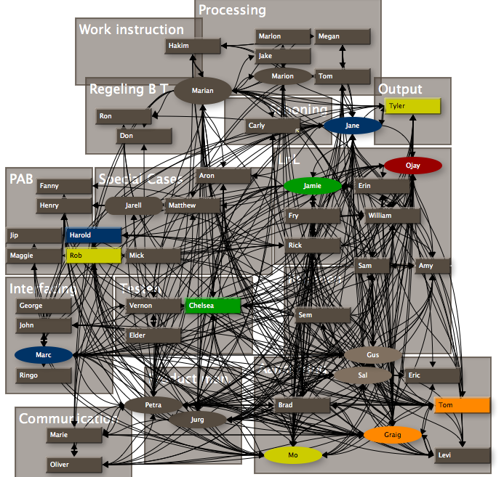
But it’s complex!
Manage complex programs
Complexity defined as uncertainty
Management of uncertainty (1)
Uncertainty belongs to the managerial unwanted domain of “unknown-unknowns” (we just don’t know);
a domain beyond risk management, risk you know, because you log them; don’t you?
We PMs need to involve top management in the concept of uncertainty
My idea is to add a complexity chapter to the project brief in which uncertainty is -implicitly- addressed

Slide 12
But it’s complex!
Manage complex programs
Complexity defined as uncertainty
Management of uncertainty (2):
“Rules”:
  Short term focus
  Iterative
  E.g. Act, Learn, Build model (Schlesinger, Kiefer, Brown, HBR 2012)
  Act: take a small step toward a goal
  Learn: evaluate the evidence you’ve created
  Build: repeat steps 1 and 2 until you accomplish goal
      Use the means at hand
      Stay within your acceptable loss or quit
      Secure only the commitment you need for the next step
      Bring along only volunteers
      Link your move to a business imperative and produce early results
      Manage expectations

Slide 13
But it’s complex!
Manage complex programs
Self-Organization
APM’s guilds, squads, tribes, dailies, matrix add new social complexity
Messy problems: people hold entirely different views on:
Whether there is a problem,
And if they agree there is, and;
What the problem is.
“In that sense messy problems are quite intangible and as a result various authors (e.g. Checkland) have suggested that there are no objective problems, only situations defined as problems by people. Given the increasing complexity of the project teams and their operating environment more and more decisions of this type arise”. (Richardson, Tait, Roos, Lissack, 2005)

Slide 14
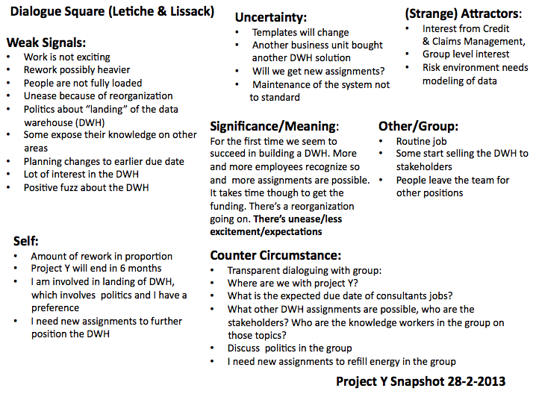
But it’s complex!
Manage complex programs
Self-Organization
Let it flow, but interfere
APM’s guilds, squads, tribes, dailies, matrix paradoxically add new social complexity;
My toolkit:
(soft) systems theory
Learning Organization
wisdom of crowds…(diverse team)
social network
Dialogue
World Café
Roadmaps based on scenarios (planning)
Frameworks

Slide 15
But it’s complex!
Manage complex programs
Self-Organization
Let it flow, but interfere
APM’s guilds, squads, tribes, dailies, matrix paradoxically add new social complexity; my toolkit:
(soft) systems theory: bottom-up, circular, grounded change processes
Concept of the Learning Organization (team learning, personal mastery, focus on mental models, shared vision (strategy)

Slide 16
But it’s complex!
Manage complex programs
Self-Organization
Let it flow, but interfere
APM’s guilds, squads, tribes, dailies, matrix paradoxically add new social complexity; my toolkit:
Belief in the wisdom of crowds …but to make that work you need a diverse team: (Surowiecki, 2004)
  Diversity of opinion (private info)
  Independence (own opinion)
  Decentralization (specialist, local knowledge)
  Aggregation (be able to totalize)
  And (BB) openness to outside knowledge and innovation; avoid knowledge to only circling internally

Slide 17
But it’s complex!
Manage complex programs
Self-Organization
Let it flow, but interfere
APM’s guilds, squads, tribes, dailies, matrix paradoxically add new social complexity; my toolkit:
Study the social network
Dialogue (generously listening to weak signals, background conversations, is something attracting the project?, significance of the project, what might “others” think?, how do we feel?)
World Café approaches (participative planning)
Roadmaps based on scenarios (planning) functional / flexible
Frameworks should not rule; more structure means less contact with emergence

Slide 18
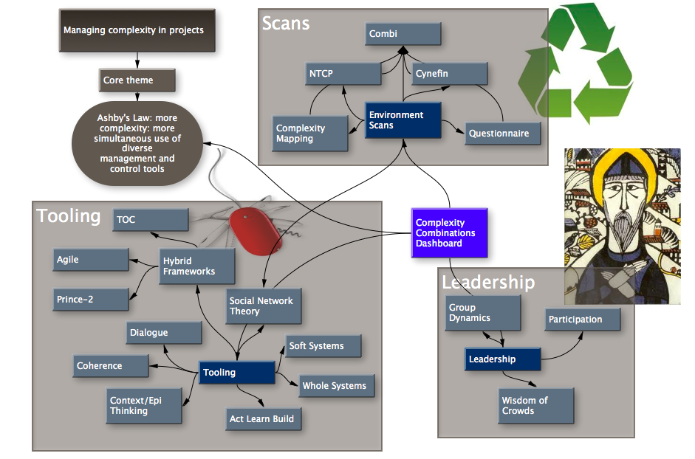
But it’s complex!
Manage complex programs
Leadership
Interpreting Ashby's Law: more complexity requires a more varied control system. The more complex your project, the more “project steering variety” you need; certainly in the complex areas of your project.
Outside
Inside

Slide 19
But it’s complex!
Manage complex programs
Leadership
Not to judgmental to soon
You need (an) authentic person (people)
Authentic meaning:
  Someone who seems vulnerable
  Is able to share with his/her team
  Listens to the team
  Is willing to change opinion
  But still is a decision taker
This in -my view- does not align wit the PM capabilities that we assess today
Notes:
Complxity needs authenticity

Slide 20
“In some mysterious way woods have never seemed
to me to be static things. In physical terms, I move
through them; yet in metaphysical ones, they seem
to move through me, just as, if I watch a film…”
John Fowles, The Tree, 1979

